Slide 1

OTT Platform Recommendation Engine
Enhancing Content Discovery for Streaming Users
Ankeet Kumar | MBA (Business Analytics)

Slide 2
Project Objectives
Design Recommendation Models: Implement and compare multiple models (Collaborative, Content-Based, and Hybrid) to enhance content discovery.
Analyze User Behavior: Analyze viewing patterns, engagement metrics, and user ratings to build robust personalization profiles.
Predict User Churn: Develop a predictive model to identify users at high risk of churning, enabling proactive retention strategies.
Integrate Sentiment Insights: Apply NLP to content descriptions and mood tags to add emotional context to recommendations.

Slide 3


The Dataset
Data Overview
Key Feature Categories
A synthetic dataset was generated to simulate real-world OTT platform interactions. It includes over 1,000 event rows and more than 25 features, providing a rich foundation for analysis.
User Demographics: `user_age`, `user_gender`, `user_region`
Engagement: `watch_time_min`, `watch_percentage`, `play_count`
Content Metadata: `primary_genre`, `description`, `director`, `main_cast`
Business Metrics: `subscription_type`, `churn_label`

Slide 4
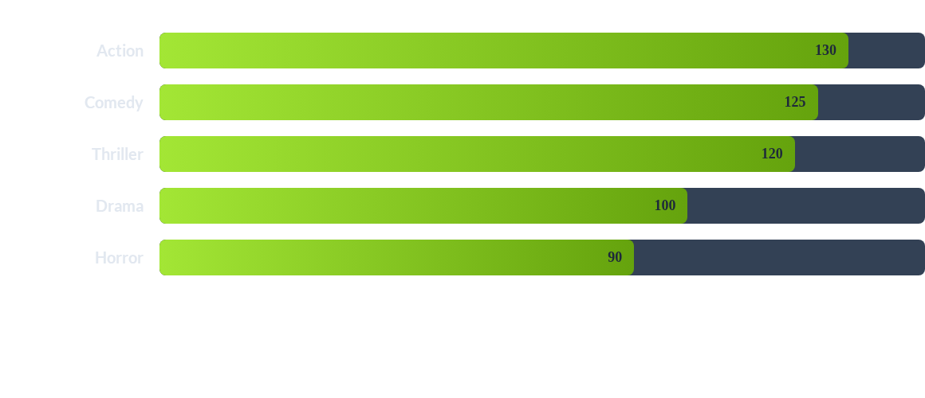
Exploratory Data Analysis: Top Genres
Initial analysis shows that Action, Comedy, and Thriller are the most frequent primary genres, providing a baseline for popularity-based models.

Slide 5






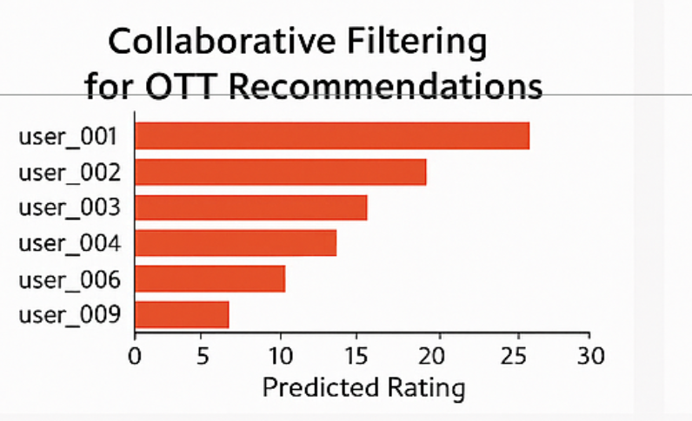
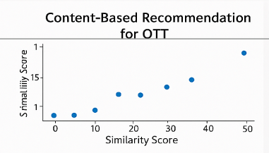
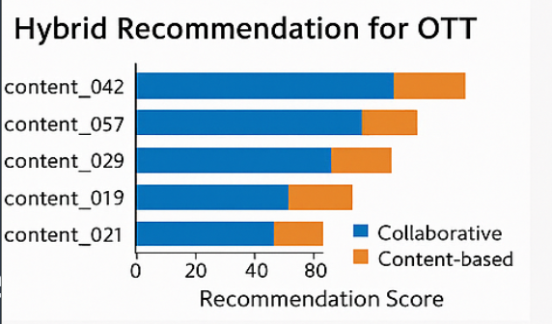
Methodology: Recommendation Models
Collaborative Filtering
Content-Based Filtering
Hybrid Engine
Uses Singular Value Decomposition (SVD) on the user-item interaction matrix to uncover latent user preferences and item factors.
Applies TF-IDF vectorization and Cosine Similarity to content metadata (genres, descriptions) to recommend functionally similar items.
Combines CF, content-based, and popularity scores into a weighted average for robust, personalized, and diverse recommendations.

Slide 6
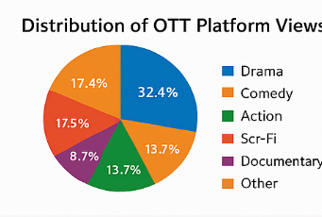
Hybrid Model Results
Balanced Recommendations
The hybrid model provides a weighted score (e.g., 60% Collaborative, 30% Content, 10% Popularity) to create a balanced recommendation list.
This approach effectively solves the "cold start" problem. When user interaction data (CF) is sparse, the model can lean on content and popularity scores to make relevant suggestions.

Slide 7


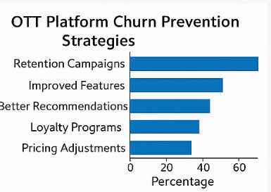
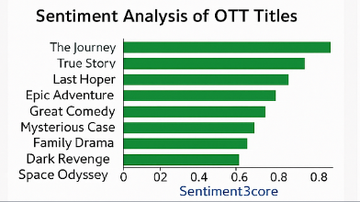
Methodology: Predictive Analytics
Use Case 4: Churn Prediction
Use Case 5: Sentiment Analysis
A random forest classifier was trained on aggregated user-level features. This model identifies users at a high risk of churning based on their behavior, subscription type, and engagement patterns.
Utilized the VADER NLP model to analyze the sentiment of content descriptions and mood tags. Each piece of content was classified as 'Positive', 'Negative', or 'Neutral' to add emotional context.

Slide 8
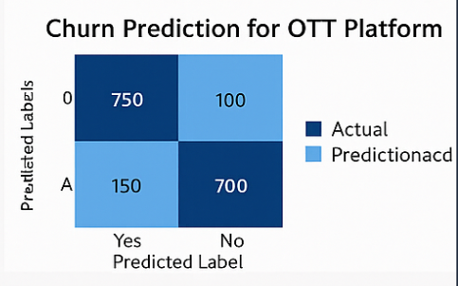
Churn Prediction: Key Insights
Top Churn Predictors
The model achieved high accuracy in identifying at-risk users. Feature importance analysis revealed that engagement metrics are the strongest predictors:
•
Watch Percentage (Mean)
•
Play Count (Sum)
•
IMDb Score (Mean)
Users with low average watch completion are flagged for proactive retention campaigns.

Slide 9
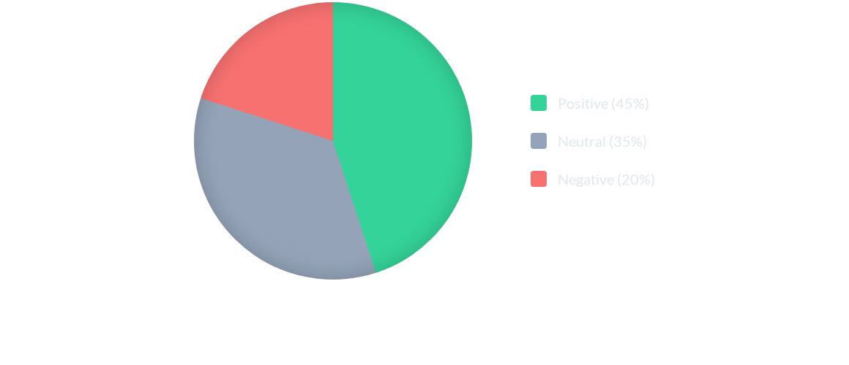
Sentiment Analysis Results
Sentiment analysis of content descriptions adds "emotional intelligence" to the engine, enabling mood-based filtering and recommendations.

Slide 10
Conclusion & Key Insights
Hybrid Model Success: The hybrid recommender successfully improved personalization accuracy over standalone models.
Engagement is Key: Engagement metrics like 'Watch Percentage' and 'Play Count' were confirmed as the strongest predictors of user churn.
Emotional Context Matters: Sentiment analysis provides valuable emotional context, enabling more nuanced, mood-based recommendations.
Scalable Framework: The modular design establishes a comprehensive and scalable framework, demonstrating a real-world application of data science in media.

Slide 11
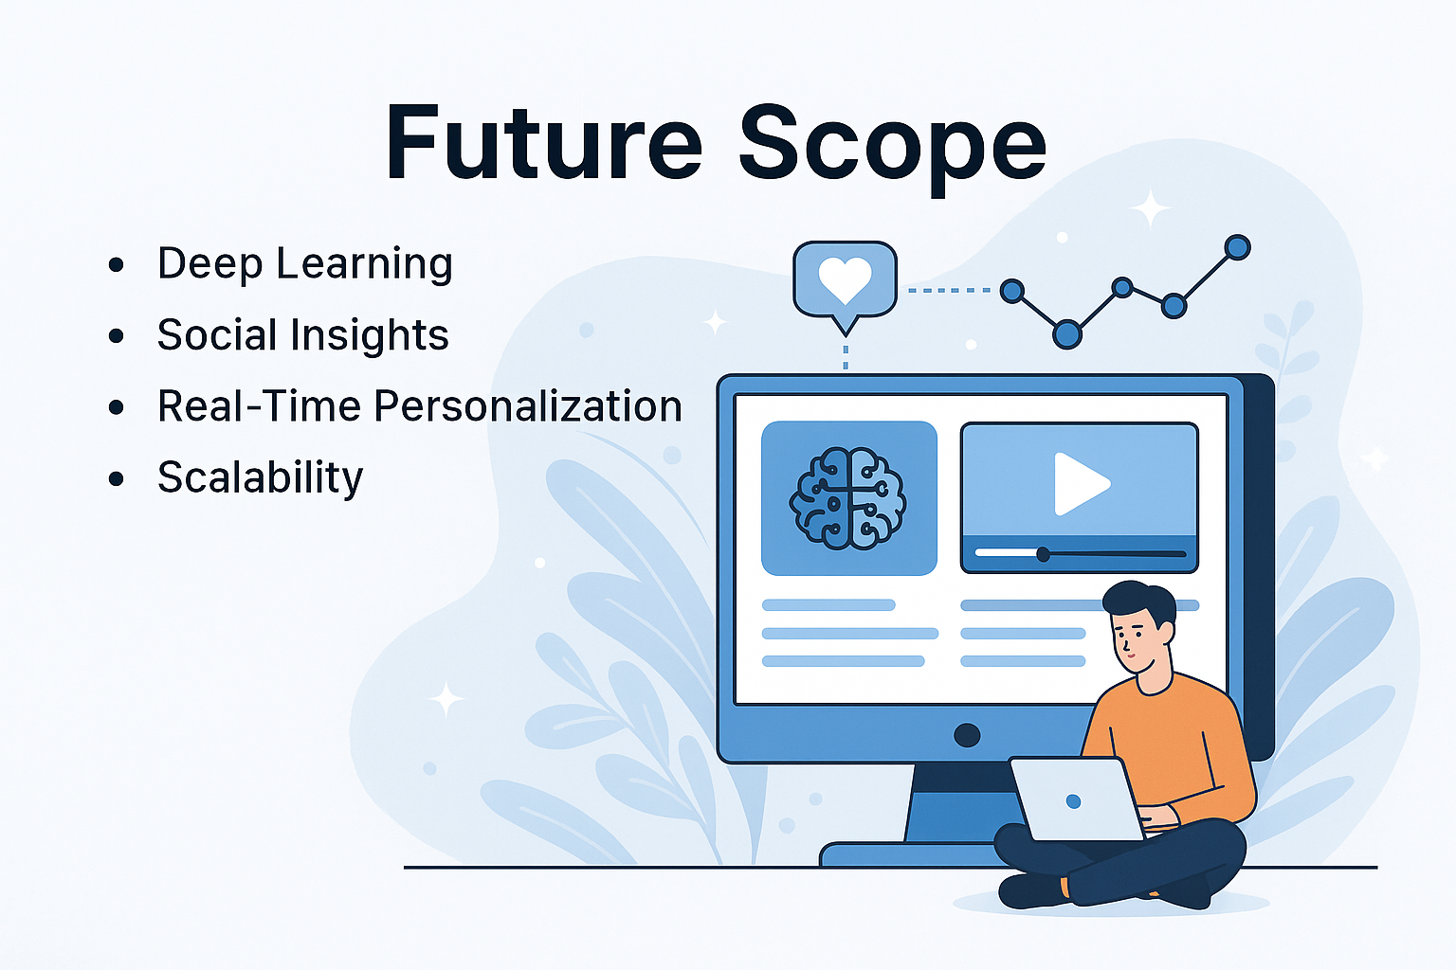
Future Scope
Potential Enhancements
•
Develop real-time recommendation updates using streaming data (e.g., Kafka, Spark).
•
Expand sentiment analysis to include user-generated social media feedback and reviews.
•
Implement deep learning models (like LSTMs) for more advanced sequence-based content prediction.
•
Integrate with a Power BI or Tableau dashboard for interactive KPI monitoring by stakeholders.

